Slide 1

Design And Analysis of Algorithms: Storage on Tapes
By
K.Yashwanth-2010030364
K.Venkatesh-2010030359
K.Pavan Vikhyath-2010030087
N.Karthik-2010030520
Under the guidance of :
MS. G.Udaya rani

Slide 2
Problem statement and domain
The objective is to find the Optimal retrieval time for accessing programs that are stored on tape.
Greedy Method:
Optimal Storage on Tapes is one of the application
of the Greedy Method.

Slide 3
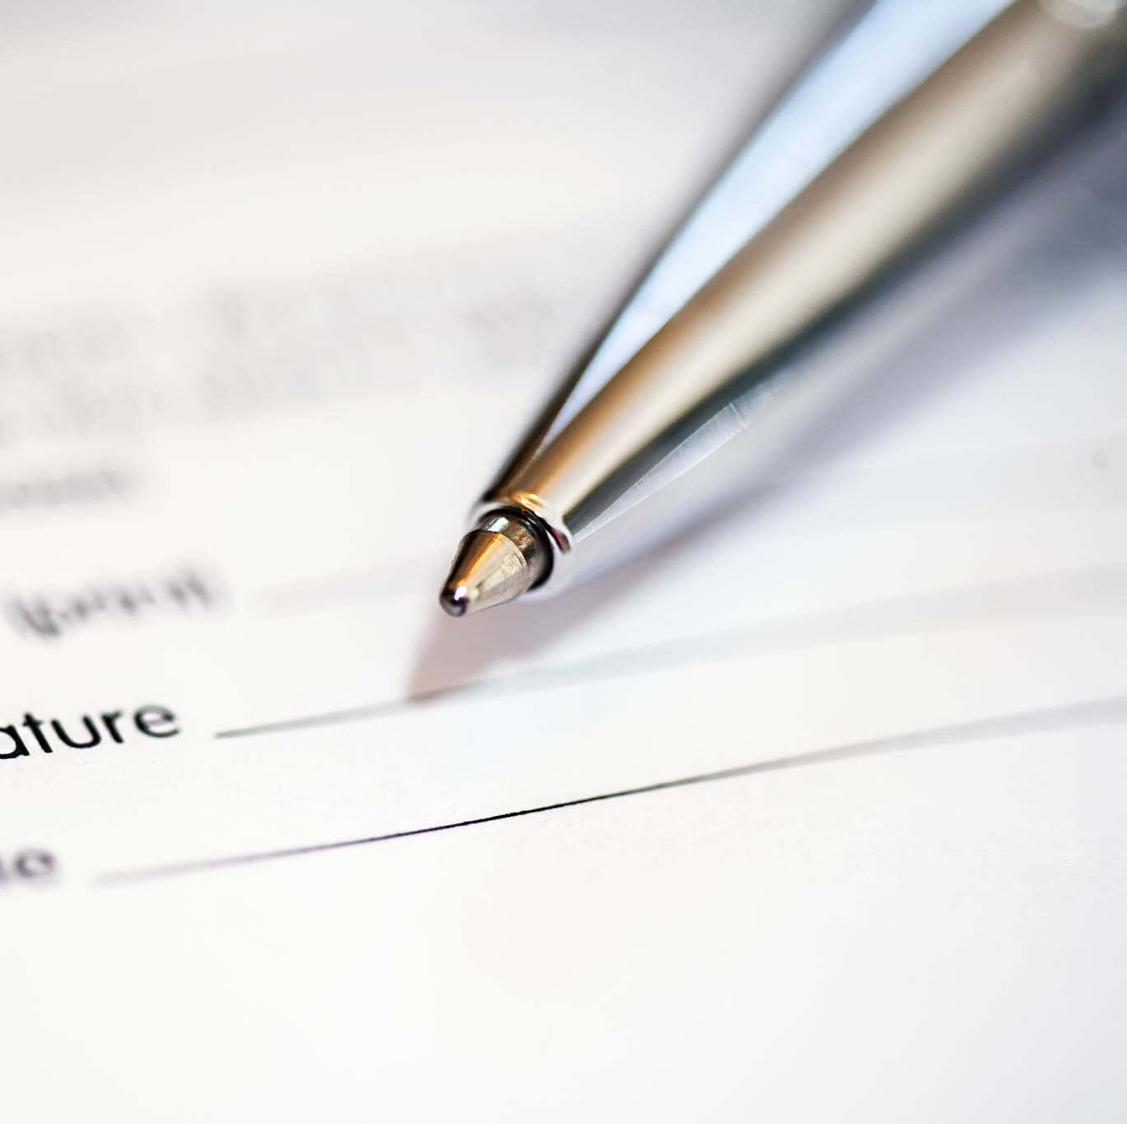
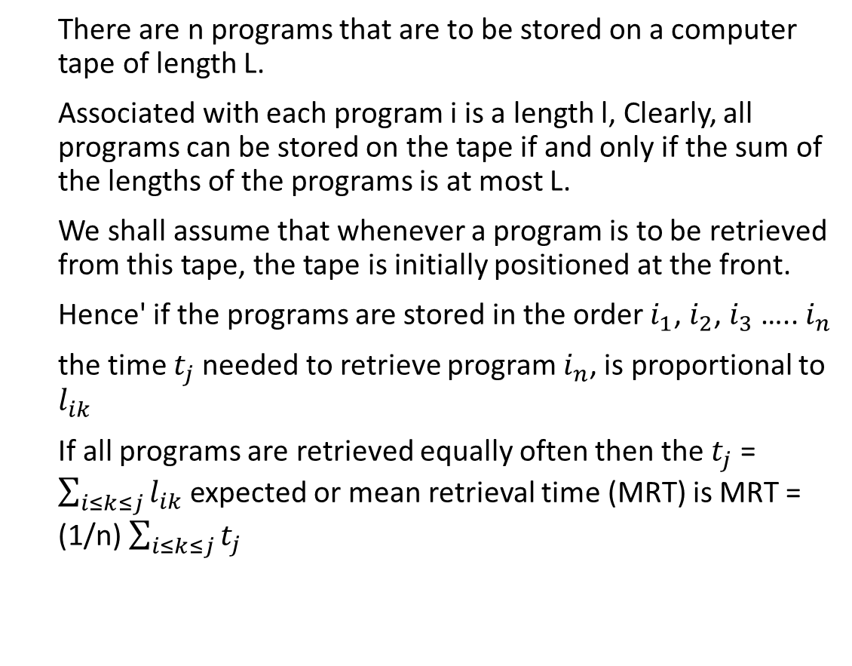
Description
There are n programs that are to be stored on a computer tape of length L.
Associated with each program i is a length l, Clearly, all programs can be stored on the tape if and only if the sum of the lengths of the programs is at most L.
We shall assume that whenever a program is to be retrieved from this tape, the tape is initially positioned at the front.
Hence' if the programs are stored in the order $i_{1}$, $i_{2}$, $i_{3}$ ….. $i_{n}$
the time $t_{j}$needed to retrieve program $i_{n}$, is proportional to $l_{ik}$
If all programs are retrieved equally often then the $t_{j}$ = $\sum_{i≤k≤j}{l_{ik}}$expected or mean retrieval time (MRT) is MRT = (1/n) $\sum_{i≤k≤j}{t_{j}}$

Slide 4
Existing solutions/ Naïve solutions
The Greedy Approach
The Greedy method is the simplest and straightforward approach. It is not an algorithm, but it is a technique. The main function of this approach is that the decision is taken on the basis of the currently available information. Whatever the current information is present, the decision is made without worrying about the effect of the current decision in future.
This technique is basically used to determine the feasible solution that may or may not be optimal. The feasible solution is a subset that satisfies the given criteria. The optimal solution is the solution which is the best and the most favorable solution in the subset. In the case of feasible, if more than one solution satisfies the given criteria then those solutions will be considered as the feasible, whereas the optimal solution is the best solution among all the solutions.

Slide 5
Proposed Algorithm Design Technique
What is the technique:
Greedy Approach
How is it suitable for your application:
The greedy method is simple for progressively building up a solution,
One element at a time, by choosing the best possible element at each stage.
What do you know about the solution of it using the proposed design method:
This method suggests that one can devise an algorithm that works in stages, considering one input at a time.

Slide 6
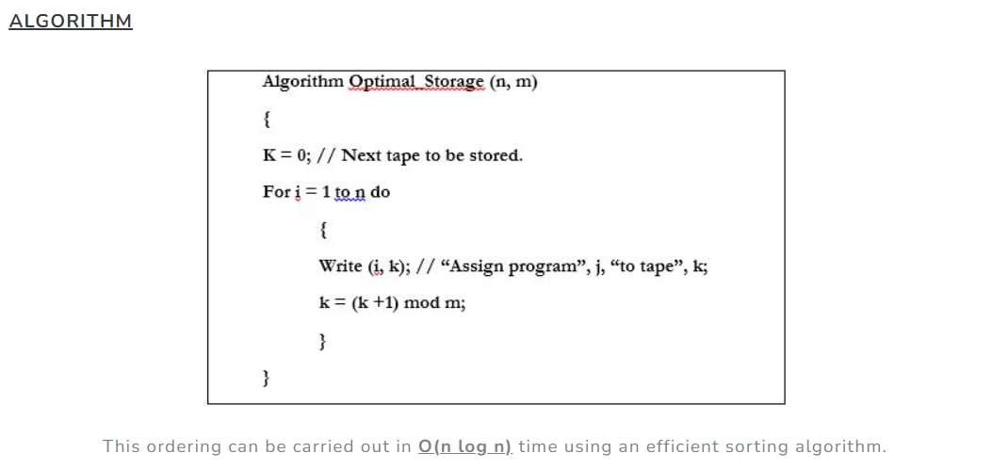
Algorithm and techniques:
The Greedy method is the simplest and straightforward approach. It is not an algorithm, but it is a technique. The main function of this approach is that the decision is taken based on the currently available information. Whatever the current information is present, the decision is made without worrying about the effect of the current decision in future
For the solution of this problem, we have used the greedy algorithm. at each step we make the immediate choice of putting the program having the least time first, in order to build up the ultimate optimized solution to the problem piece by piece. The algorithm used is shown in the image. This ordering can be carried out in O(n log n) time using an efficient sorting algorithm.

Slide 7
How is it suitable for your application:
Let us first break down the problem and understand what needs to be done.
A magnetic tape provides only sequential access of data. In an audio tape unlike a CD, a fifth song from the tape can’t be just directly played.
The length of the first four songs must be traversed to play the fifth song. So in order to access certain data, head of the tape should be positioned accordingly. Now, considering that all programs in a magnetic tape are retrieved equally often and the tape head points to the front of the tape every time, a new term can be defined called the Mean Retrieval Time (MRT).

Slide 8
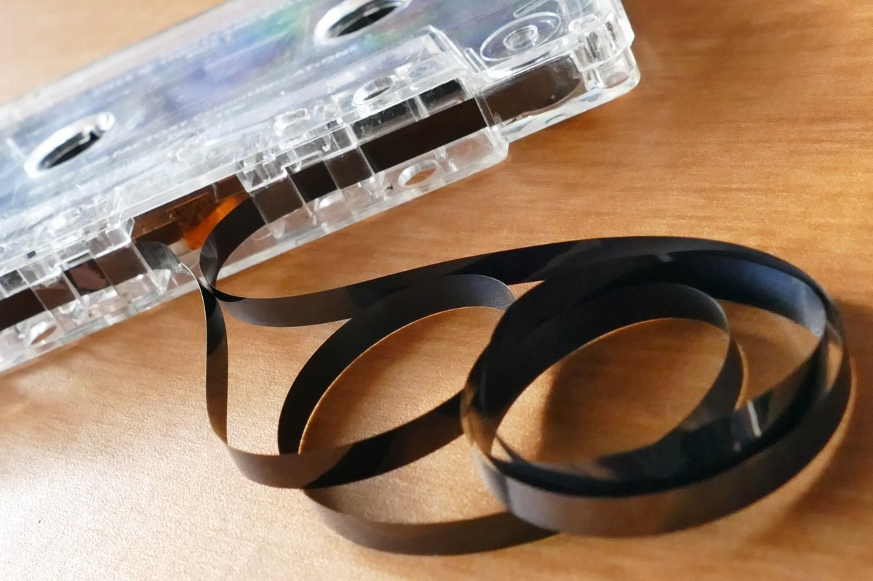
What do you know about the solution of it using proposed design method
By using the Greedy Algorithm at each step, we make the immediate choice of putting the program having the least time first, to build up the ultimate optimized solution to the problem piece by piece.
The greedy method simply requires us to store the programs in non-decreasing order of their lengths.
This ordering (sorting) can be carried out in O(n log n) time using an efficient sorting algorithm.

Slide 9
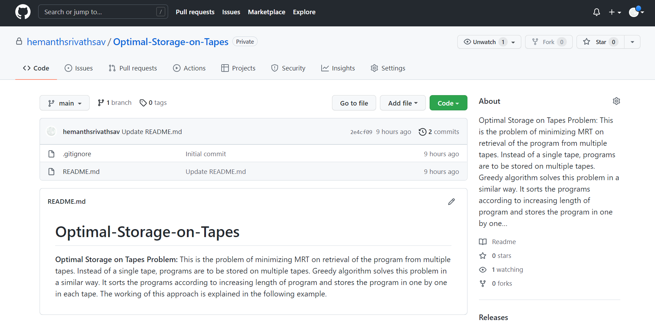
Github setup
https://github.com/klhyd/Optimal-Storage-On-Tapes

Slide 10
Division of work among the group members
Venkatesh
Pavan Vikhyath
Karthik
Yashwanth
GitHub setup , Presentation
& Analysis of optimal
scenario
Presentation, Techniques
& Analysis of Algorithm
Description of work with
Analysis of code
Greedy Approach &
Optimality condition

Slide 11
Thank you

